Slide 1
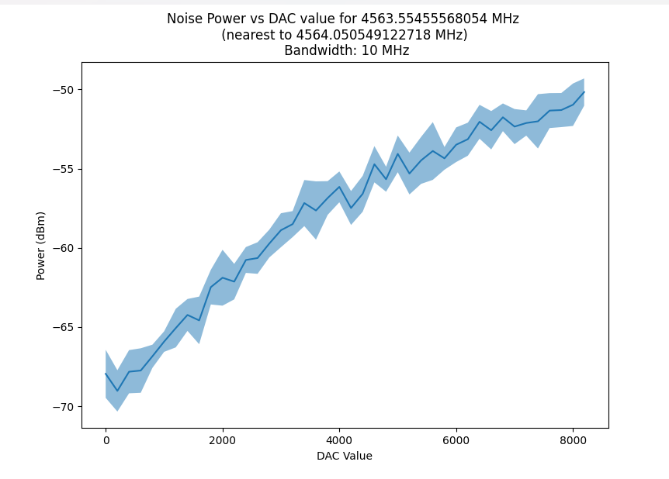
Effects of white noise on fidelity
300 K
4 K
100 mK
10 mK
Noise Power Measurement for Different DAC amplitudes
Noise
DAC1
RFSoC
+15 dB
-20 dB
-20 dB
-20 dB
Qubit
Signal
DAC0
-14.8 dBm
$$Signa to Noise Ratio (SNR)=\frac{{Power}_{peak}^{signal}}{{Average Power }_{BW}^{noise}}$$
Noise BW
Power (dBm)
f
f_{qubit}

Slide 2
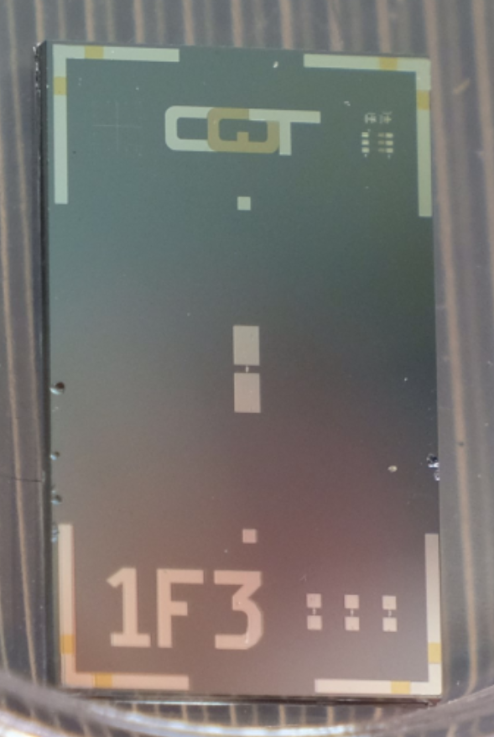
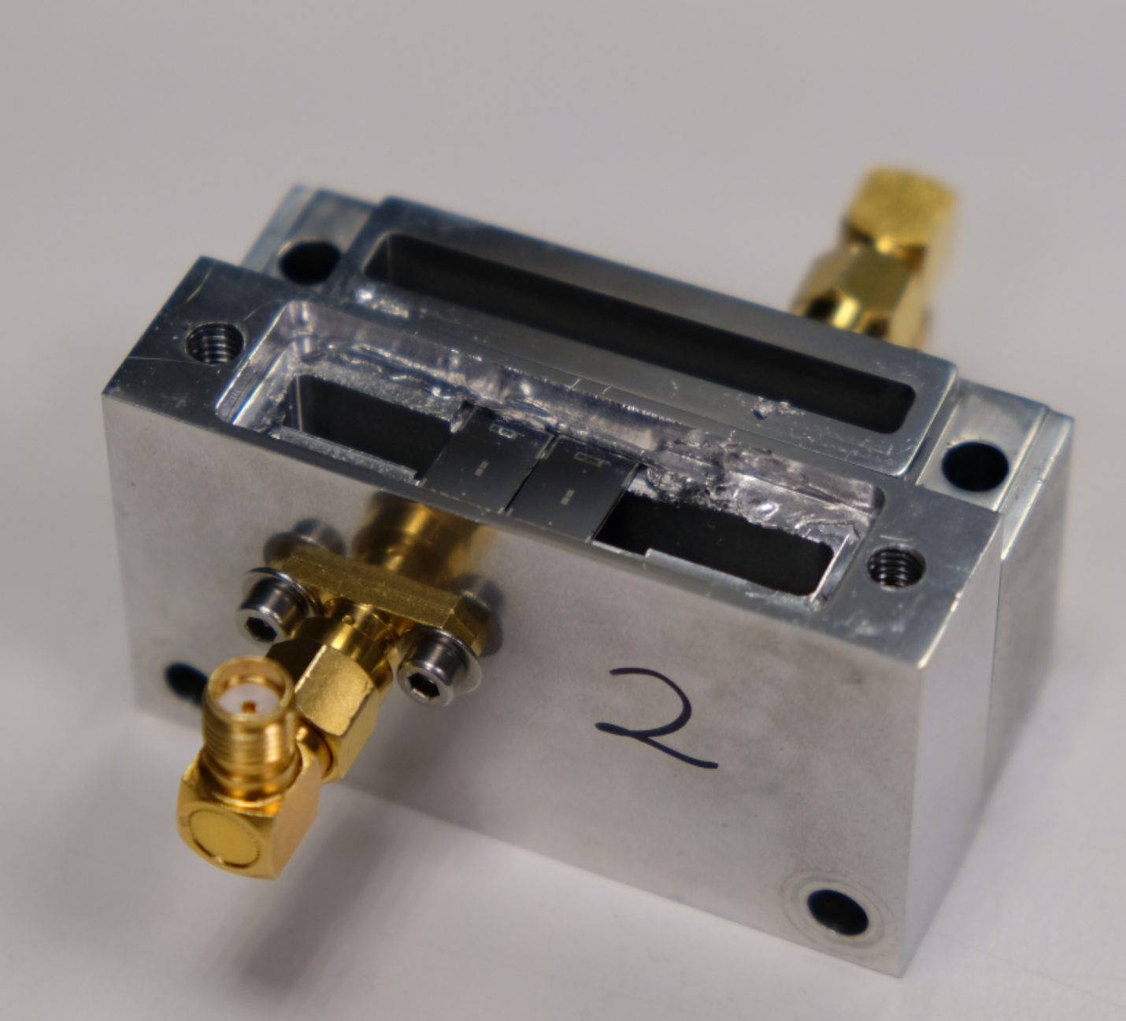
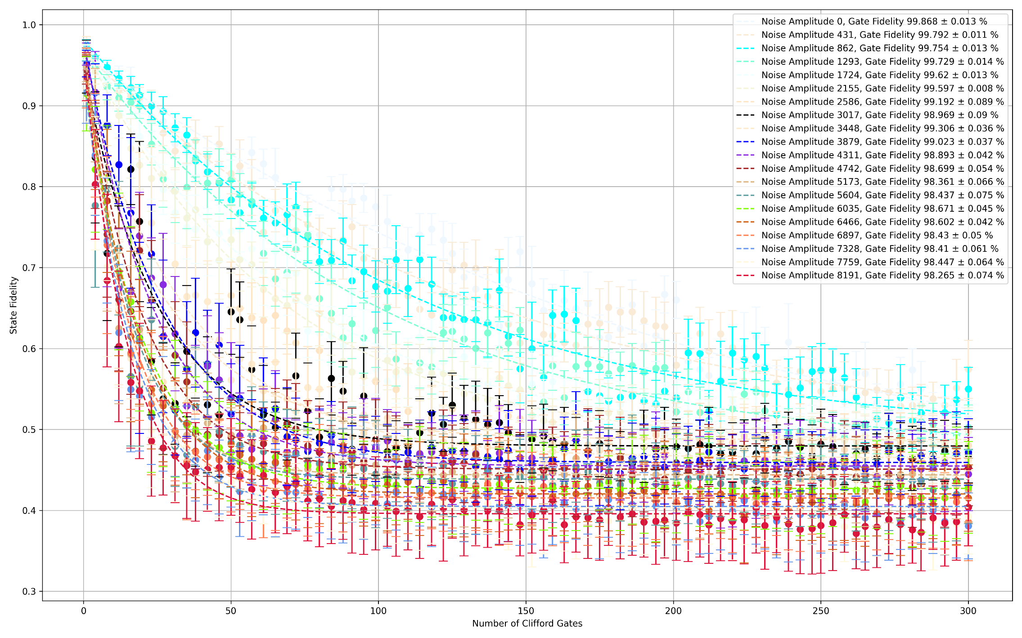
Effects of white noise on fidelity
300 K
4 K
100 mK
10 mK
Noise
DAC1
RFSoC
+15 dB
-20 dB
-20 dB
-20 dB
Qubit
Signal
DAC0
-14.8 dBm

Slide 3
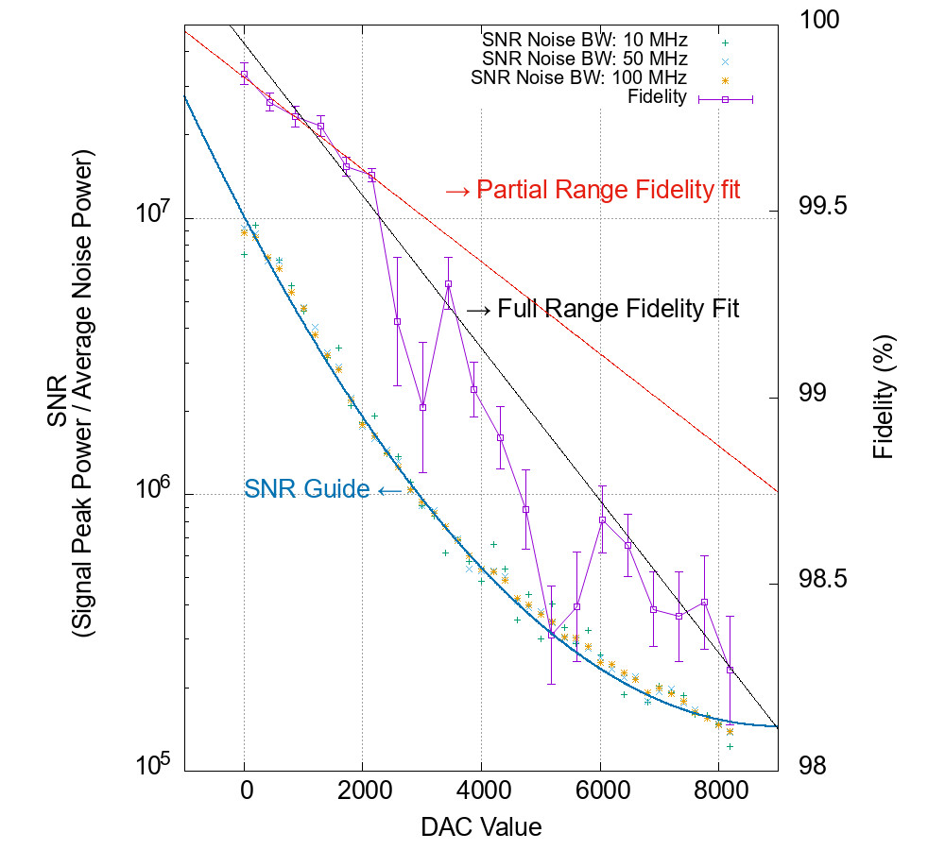
Effects of white noise on fidelity
300 K
4 K
100 mK
10 mK
Noise
DAC1
RFSoC
+15 dB
-20 dB
-20 dB
-20 dB
Qubit
Signal
DAC0
-14.8 dBm

Slide 4
Effects of white noise on fidelity
Without any additional noise:
Fidelity = 99.87%
300 K Thermal Noise = -77 dBm @ 4.5 GHz
To achieve 99.9% fidelity, we need:
SNR: ≈ 1.3 x 10⁷
or Average noise floor: - 71 dBm
To achieve 99.99% fidelity, we need:
SNR: ≈ 3 x 10⁷
or Average noise floor: - 74 dBm

Slide 5
Effects of white noise on fidelity
Without any additional noise:
Fidelity = 99.87%
300 K Thermal Noise = -77 dBm @ 4.5 GHz
To achieve 99.9% fidelity, we need:
SNR: ≈ 1.3 x 10⁷
or Average noise floor: - 71 dBm
To achieve 99.99% fidelity, we need:
SNR: ≈ 3 x 10⁷
or Average noise floor: - 74 dBm
Need to bring down the average
noise floor to around: - 75 dBm
Next todo: Investigate only the phase noise with constant amplitude towards fidelity.

